Slide 1
Maximum Distance Gradient for Robust Image Registration
Chrouk Kasem

Slide 2
Skeleton
Introduction:
Image Registration: Applications And Limitations
Theory:
Why Mutual Information In Image Registration?
Limitations Of Mi And Proposed Improvements
MDG Feature Field Vs. Intensity Gradient
What’s MDG Feature Field? Signed MDG Feature Field
Similarity Metric : 4-dimensional MI And Orientation Information Of Signed MDG
Implementation:
Flowchart :
Import Image
Multi-resolution Gaussian Pyramid
At Each Resolution:
Find Signed MDG Feature Field
Find 4D MI That Takes Magnitude Of MDG Feature Field
Find Orientation Information Of The Signed MDG Feature Field
Compute Similarity Metric
Find Transformation That Yields That Maximizes S
Results And Discussion:
Probing Plots Of Proposed Similarity Metric Versus Conventional 2-d MI Measure
Registered Image Error Bar
Summary
Questions

Slide 3
Outline
Introduction:
Image Registration: Applications And Limitations
Theory:
Why Mutual Information In Image Registration?
Limitations Of Mi And Proposed Improvements
MDG Feature Field Vs. Intensity Gradient
What’s MDG Feature Field? Signed MDG Feature Field
Similarity Metric : 4-dimensional MI And Orientation Information Of Signed MDG
Implementation:
Flowchart :
Import Image
Multi-resolution Gaussian Pyramid
At Each Resolution:
Find Signed MDG Feature Field
Find 4D MI That Takes Magnitude Of MDG Feature Field
Find Orientation Information Of The Signed MDG Feature Field
Compute Similarity Metric
Find Transformation That Yields That Maximizes S
Results And Discussion:
Probing Plots Of Proposed Similarity Metric Versus Conventional 2-d MI Measure
Registered Image Error Bar
Summary
Questions

Slide 4
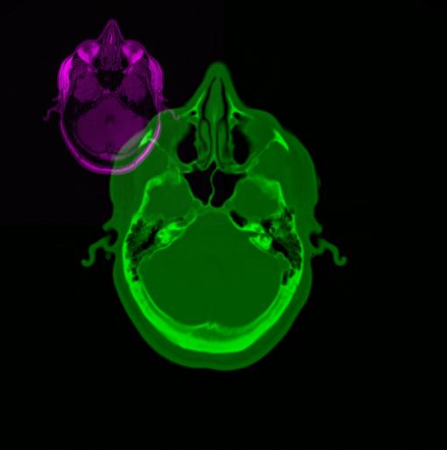
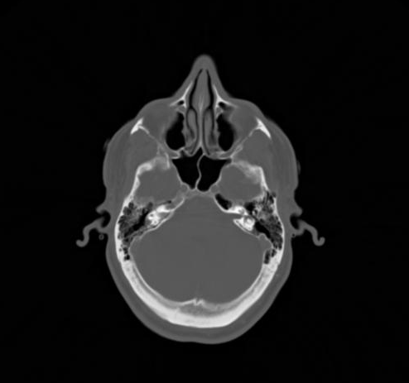
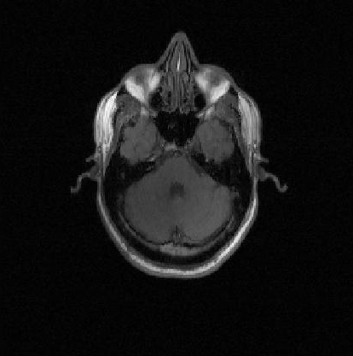
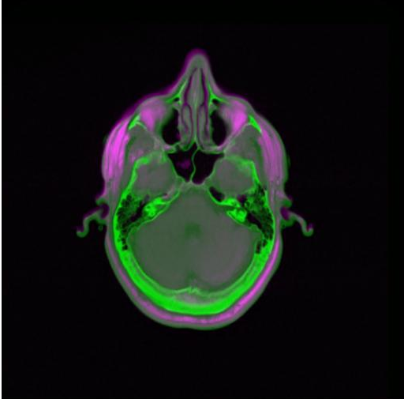
Image Registration
test
Image registration in medical imaging

Slide 5
Image Registration - Limitations
Need to find a transformation matrix that aligns images
Multi-modal : images from different resolutions
Intensity-based versus

Slide 6
Why Mutual Information?
Assumes NO LIMITING FUNCTIONAL RELATIONSHIP between image intensity pairs in the images
Measures statistical dependence between two image intensities

Slide 7
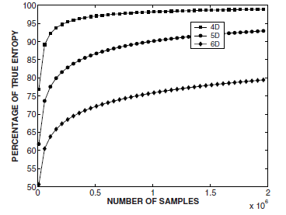
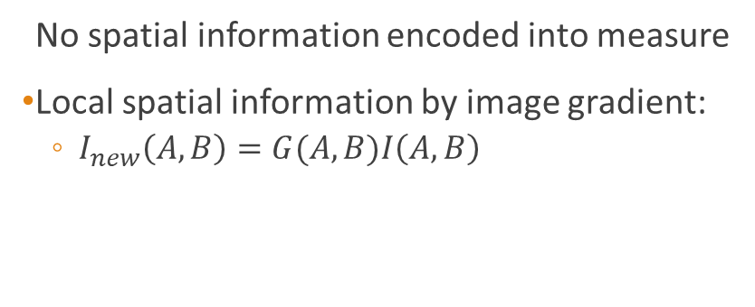
Limitations Of MI And Proposed Improvements
Regional mutual information
No spatial information encoded into measure
Takes into account neighborhood regions of pixel pairs.
Mutual information and image gradient
No spatial information encoded into measure
Local spatial information by image gradient:
$I_{new}\left(A, B\right)=G(A,B)I\left(A, B\right)$
Notes:
Mutual information is a global metric, sensitive to occlusions, non-homogenious image intensity response. Maybe a result of overlap invariance, images of low resolution or interpolation methods
No spatial context

Slide 8
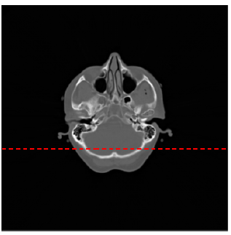
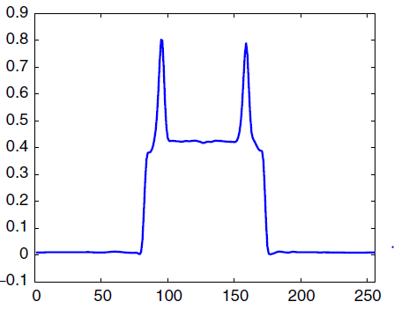
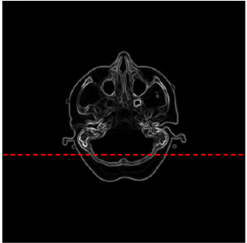
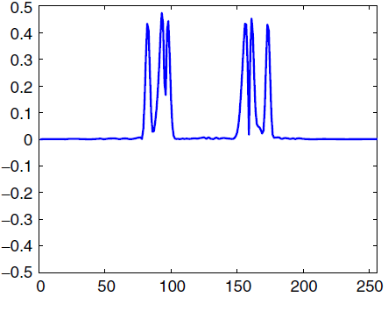
Image Gradient
Notes:
Local edge information and globally defined spatial information.
Image gradient can be used to detect object boundaries, sudden intensity changes between voxels indicate a boundary. Only locally defined. Object boundaries occupy a small proportion of medical images, while anatomical structures and other locations in the background occupy a large proportion of voxels. This limits the effectiveness in image gradient feature in registeration of medical images,=

Slide 9
What is MDG Feature Field? Signed MDG Feature Field
Spatial Feature field called maximum distance gradient
Intensity Difference
Distance
The direction of voxel to a MDG SOURCE PINT
Encodes both local edge information and spatial information at a global level.

Slide 10
Similarity Metric : 4-dimensional MI And Orientation Information Of Signed MDG

Slide 11
Implementation - Multi-resolution Gaussian Pyramid

Slide 12
Implementation - Find Signed MDG Feature Field

Slide 13
Implementation – Find 4-D MI Measure

Slide 14
Implementation - Find Orientation Information Of The Signed MDG Feature Field

Slide 15
Implementation - Compute Similarity Metric

Slide 16
Implementation - Find Transformation That Yields That Maximizes S

Slide 17
Probing Plots Of Proposed Similarity Metric Versus Conventional 2-d MI Measure

Slide 18
Probing Plots Of Proposed Similarity Metric Versus Conventional 2-d MI Measure

Slide 19
Registered Image Error Bar
Translation in x-y with -40 – 90 : successful
Perturbations in all axes: x-axis trans: 32 y-axis trans :-80 z-axis trans : 2
x-axis rotation: 16 degrees. y-axis rotation: 4, z-axis rotation: -8 degrees FAILED to align in all axes of rotations

Slide 20
Summary

Slide 21
Thank you!
Questions?

